Slide 1
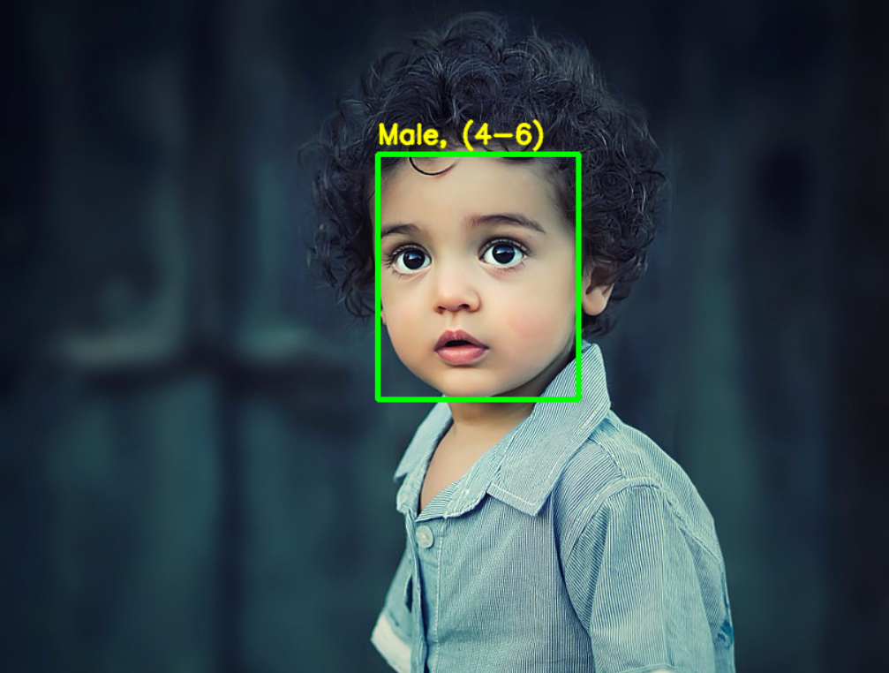
Gender and Age Detection

Slide 2



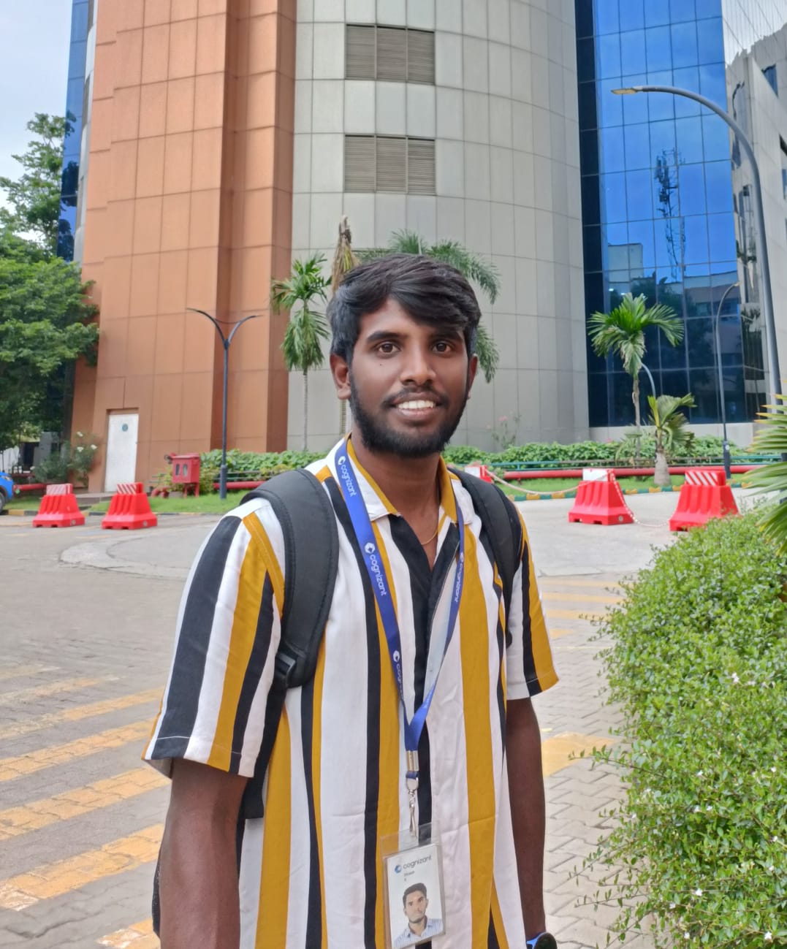
Team Members:
Lokesh
Gopi
Careen
Dinesh
Project Lead and Storytelling
Data Scientist/Analyst
Machine Learning Engineer
Data Visualization Specialist

Slide 3
Objective:​
​
To build a gender and age detector that can approximately guess the gender and age of the person (face) in a picture or through webcam.

Slide 4
Problem Statement:​​
How can we effectively leverage a gender and age detection solution to enhance customer experiences and business operations across various industries while ensuring privacy, compliance, and ongoing accuracy?​

Slide 5

Problem Breakdowns & Solutions:
Retail and Marketing:
Security and Access Control:
Campaigns to specific demographic groups based on age and gender insights obtained from in-store cameras and also optimize product placement.
Implement age and gender-based access controls in secure environments, such as casinos, bars, or age-restricted facilities.​
​
Entertainment & Content
Recommendation:
Hospitality & Customer
Service:
Personalize content recommendations for streaming platforms, gaming, and digital media based on the estimated age and gender of users.
Personalize guest experiences in hotels and resorts by understanding the age and gender of visitors.

Slide 6

Data:​​
For this python project, we will use the Adience dataset; the dataset is available in the public domain Kaggle. Please find the below link​
​
https://www.kaggle.com/datasets/ttungl/adience-benchmark-gender-and-age-classification/data​
​
Dataset Description:​
​
This dataset serves as a benchmark for face photos and is inclusive of various real-world imaging conditions like noise, lighting, pose, and appearance. The images have been collected from Flickr albums and distributed under the Creative Commons (CC) license. It has a total of 26,580 photos of 2,284 subjects in eight age ranges.​

Slide 7
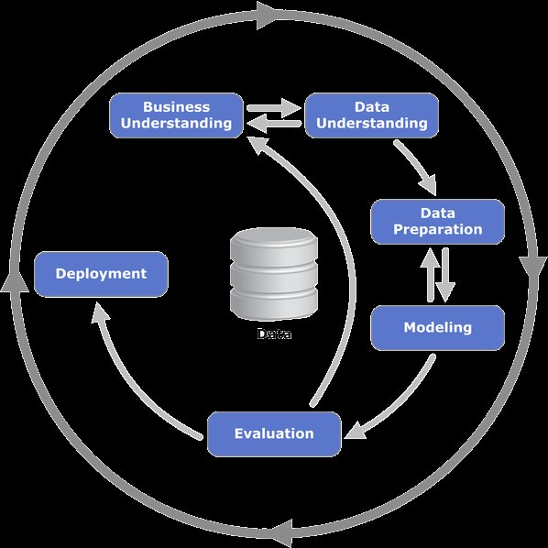
CRISP-DM Methodology:
​

Slide 8

Business Understanding:​​
Understand the business problem, objectives, and the importance of gender and age detection. For example, it could be used for targeted marketing, content personalization, or customer segmentation. Identify stakeholders and their requirements: Determine who the key stakeholders are and gather their input on what they expect from the gender and age detection model.

Slide 9
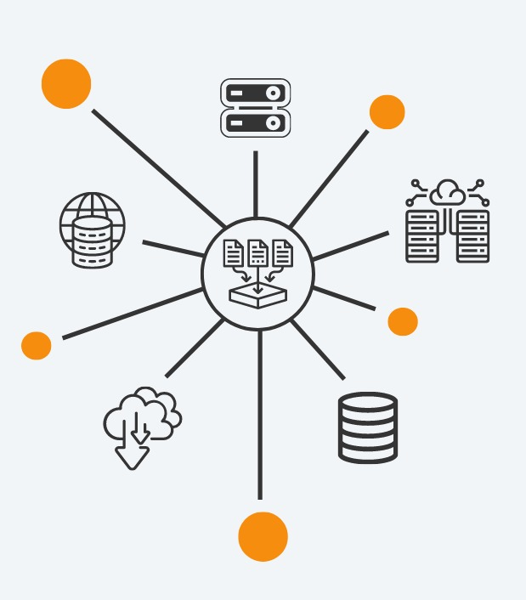
Data Understanding:​​
Data Collection: Gather relevant data sources, which may include images, customer profiles, or any other relevant information.
Data Exploration: Explore the data to understand its quality, completeness, and distribution. Identify any missing or noisy data.

Slide 10
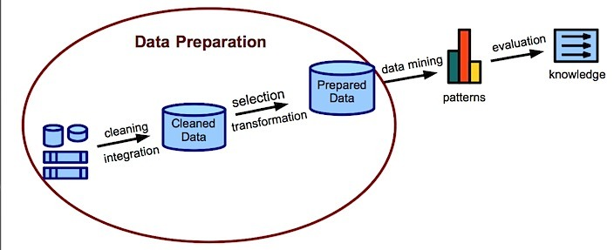
Data Preparation:
Data Cleaning: Address missing data, outliers, and errors in the dataset.
Data Transformation: Convert the data into a suitable format for analysis, which may involve image preprocessing, feature extraction, or encoding categorical variables.
Feature Engineering: Create or select relevant features that can help in gender and age detection, such as facial landmarks, hair color, clothing style, etc.

Slide 11
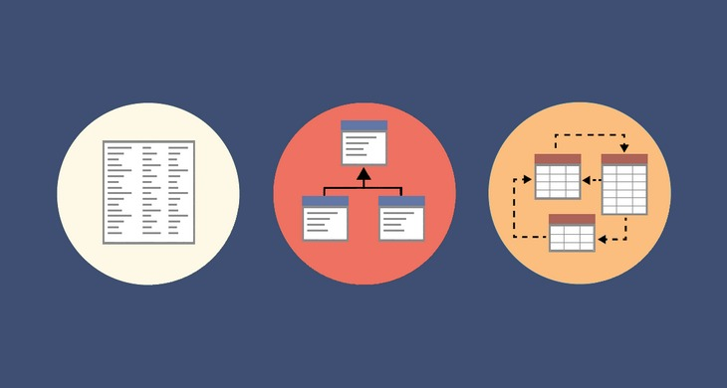
Modeling:
Select the appropriate machine learning or deep learning algorithms for gender and age detection. Common choices may include convolutional neural networks (CNNs) for image-based tasks.
Train and test multiple models, fine-tuning hyperparameters and evaluating their performance using appropriate metrics.
Consider techniques for handling class imbalance, as gender and age groups may not be evenly distributed in the dataset.

Slide 12
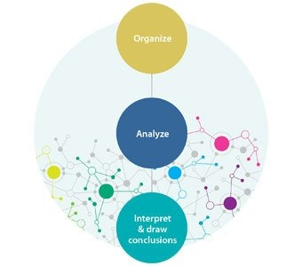
Evaluation:
Assess model performance using appropriate evaluation metrics, such as accuracy, precision, recall, and F1 score for gender and age classification.
Validate the model on a hold-out dataset or through cross-validation to ensure it generalizes well to unseen data.
Conduct a cost-benefit analysis to evaluate the model's business impact.

Slide 13
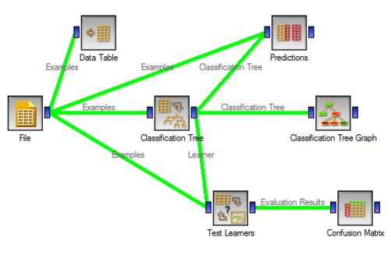
Deployment:
Integrate the gender and age detection model into the desired application or system, whether it's a mobile app, website, or marketing platform. Ensure model deployment is scalable, reliable, and meets privacy and security requirements.

Slide 14
THANK YOU

